Slide 1
Lecture 3 CDS-292
Joseph Shaheen

Slide 2
History
Moreno (1934)
Bott (1957)
Erdos & Renyi (1959)
Traverse & Milgram (1969)
Granovetter (1973)
Freeman (1970s)
Holland & Reinhard (1981); Krackhardt (1987)
Barabasi, Wattz and Strogatz (1990s)
Newman, Snijders (2000s)

Slide 3
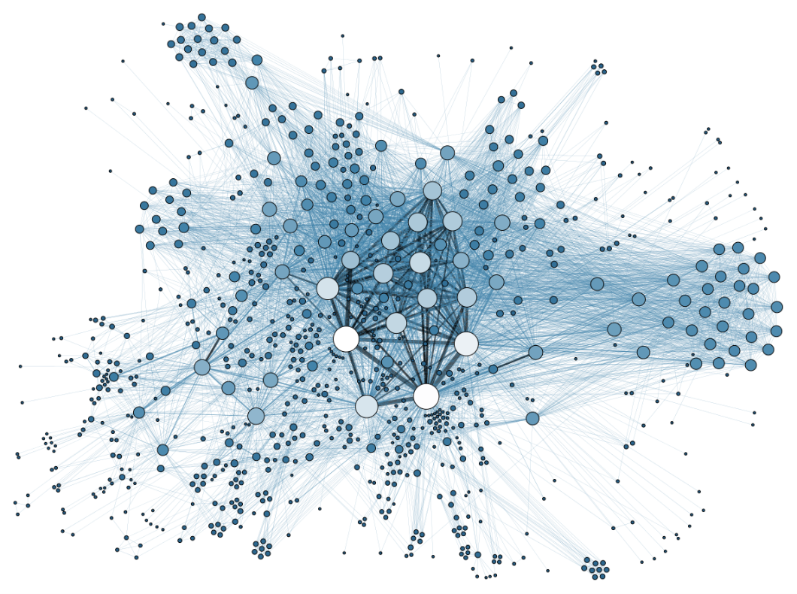
Background
A Network: Nodes, Actors, Vertices connected by edges, ties, relations
Can be single mode, or n-partite
Can be measured and analyzed through structural/mathematical metrics acting on multiple levels: Node-level, Dyad-level, Network as a whole

Slide 4
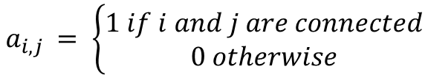
Degree of a Node
Different nodes will have different degrees. To track the number of connections each node has we introduce the term Node Degree, or as it is more commonly known, Degree
$k_{i}$ is the number of total links connected to node i
To keep track of the number of links between 2 nodes, say node i and node j, mathematically, we introduce a simple function that we call the link indicator. It’s basically an on or off switch.
$$a_{i, j }= \left\{\begin{aligned}1 if i and j are connected \\ 0 otherwise\end{aligned}\right.$$

Slide 5
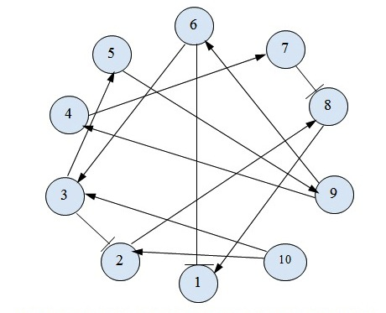
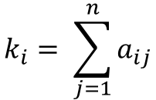
To Calculate the Node Degree
$$k_{i}= \sum_{j=1}^{n}{a_{ij}}$$
Let’s look at an example:
Source: https://www3.beacon-center.org/blog/2014/03/03/beacon-researchers-at-work-constructing-models-for-gene-regulatory-networks/

Slide 6
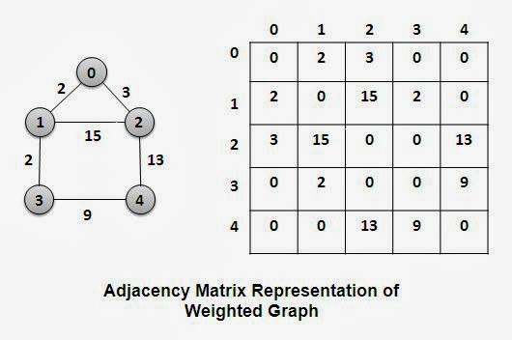
Adjacency Matrix Example
https://www.thecrazyprogrammer.com/2014/03/representation-of-graphs-adjacency-matrix-and-adjacency-list.html

Slide 7
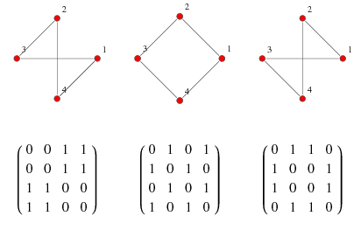
Simple Adjacency Matrix

Slide 8
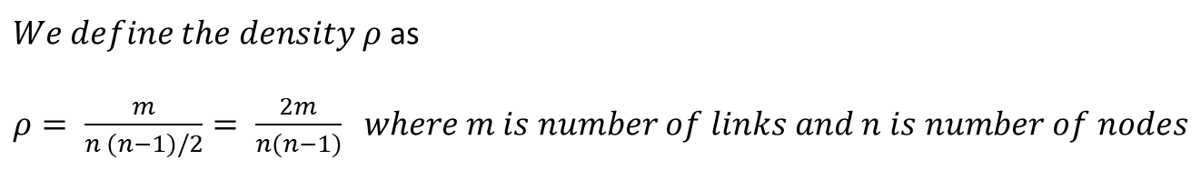
Introducing Density
Density is a very useful network-level metric property
It tell us how sparse or full a network is and this has interesting sociological and physical interpretations
$We define the density ρ$ as
$ρ= \frac{m}{n (n−1)/2}= \frac{2m}{n(n−1)}$ $where m is number of links and n is number of nodes$

Slide 9
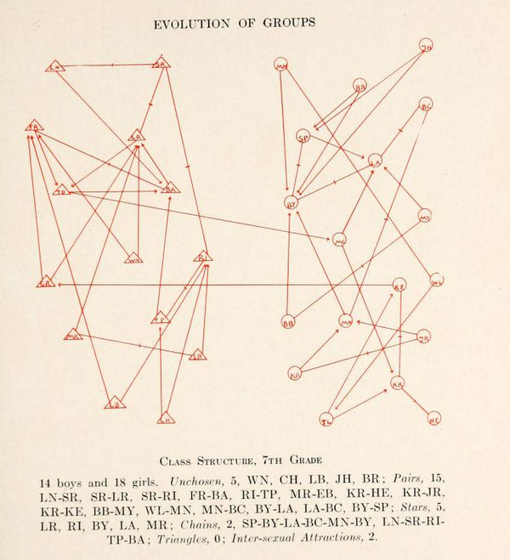
Moreno (1934)

Slide 10
Moreno Data Set
Organized as a list of edges
BA AB
BA BR1
DE EP
Node1 Node2

Slide 11
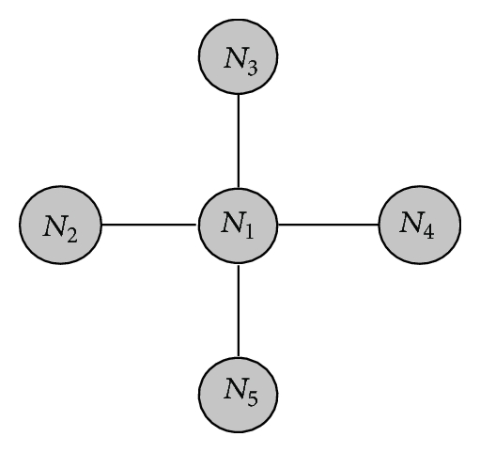
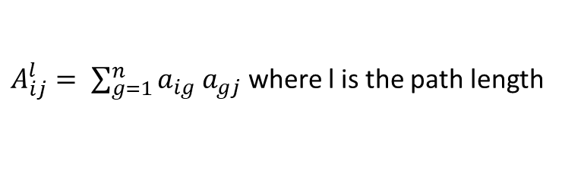
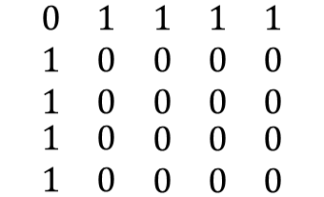
Finding Path Length (all types through matrix algebra)
$A_{ij}^{l}= \sum_{g=1}^{n}{a_{ig} a_{gj}}$ where l is the path length
In other words, to find out how many paths of length 2 exist between every node i and every node j,
we simply multiply the adjacency matrix by itself. For path length 3, we multiply the adjacency matrix by itself 3 times..etc..
Example
$$\begin{matrix}\begin{matrix}0 \\ 1 \\ 1\end{matrix} & \begin{matrix}1 \\ 0 \\ 0\end{matrix} & \begin{matrix}\begin{matrix}1 & 1 & 1\end{matrix} \\ \begin{matrix}0 & 0 & 0\end{matrix} \\ \begin{matrix}0 & 0 & 0\end{matrix}\end{matrix} \\ 1 & 0 & \begin{matrix}0 & 0 & 0\end{matrix} \\ 1 & 0 & \begin{matrix}0 & 0 & 0\end{matrix}\end{matrix}$$
How many paths exist between every node of distance/path length 2?

Slide 12
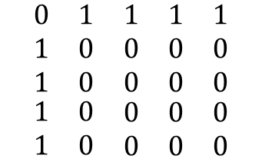
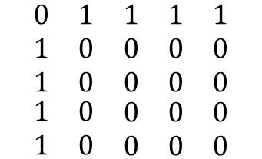
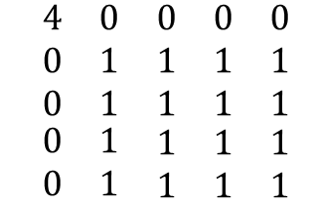


Finding Path Length (Cont)
$$\begin{matrix}\begin{matrix}0 \\ 1 \\ 1\end{matrix} & \begin{matrix}1 \\ 0 \\ 0\end{matrix} & \begin{matrix}\begin{matrix}1 & 1 & 1\end{matrix} \\ \begin{matrix}0 & 0 & 0\end{matrix} \\ \begin{matrix}0 & 0 & 0\end{matrix}\end{matrix} \\ 1 & 0 & \begin{matrix}0 & 0 & 0\end{matrix} \\ 1 & 0 & \begin{matrix}0 & 0 & 0\end{matrix}\end{matrix}$$
$$\begin{matrix}\begin{matrix}0 \\ 1 \\ 1\end{matrix} & \begin{matrix}1 \\ 0 \\ 0\end{matrix} & \begin{matrix}\begin{matrix}1 & 1 & 1\end{matrix} \\ \begin{matrix}0 & 0 & 0\end{matrix} \\ \begin{matrix}0 & 0 & 0\end{matrix}\end{matrix} \\ 1 & 0 & \begin{matrix}0 & 0 & 0\end{matrix} \\ 1 & 0 & \begin{matrix}0 & 0 & 0\end{matrix}\end{matrix}$$
$$\begin{matrix}\begin{matrix}4 \\ 0 \\ 0\end{matrix} & \begin{matrix}0 \\ 1 \\ 1\end{matrix} & \begin{matrix}\begin{matrix}0 & 0 & 0\end{matrix} \\ \begin{matrix}1 & 1 & 1\end{matrix} \\ \begin{matrix}1 & 1 & 1\end{matrix}\end{matrix} \\ 0 & 1 & \begin{matrix}1 & 1 & 1\end{matrix} \\ 0 & 1 & \begin{matrix}1 & 1 & 1\end{matrix}\end{matrix}$$
$$×$$
$$≔$$
There is at least 1, distance 2 path length path between every node except N1

Slide 13
Small World vs. Large World
Small versus large worlds is a concept heavily dependent on the idea of path length.
In a small world the average path length between nodes tends to be small, and in a large world, the distance can be large, even enormous.
What Traverse and Milgram (69) showed was that the modern world’s communication infrastructure allows us to model it as a small world. That was a breakthrough!

Slide 14
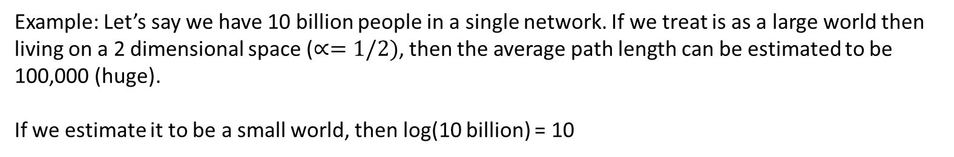
Small World vs. Large World
…and we know a little about how the average path length behaves for typical small world and large world networks.
$$\left\langle l\right\rangle ∝ \left\{\begin{aligned}n^{α} \\ \log{n}\end{aligned}where 0< α ≤1, n is the number of nodes\right.$$
$$(though is isn^{′}t mentioned, but alpha is a fractal dimension)$$
Example: Let’s say we have 10 billion people in a single network. If we treat is as a large world then
living on a 2 dimensional space ($∝=1/2)$, then the average path length can be estimated to be 100,000 (huge).
If we estimate it to be a small world, then log(10 billion) = 10

